Slide 1
Quantum AI-Based Medical Imaging System for Disease Diagnosis from Medical Scans
QUANTUM COMPUTING CAPSTONE PROJECT
RY
RY
⟨Z⟩
RY
RZ
⟨Z⟩
RY
RY
⟨Z⟩
Hybrid Classical–Quantum Machine Learning for Multi-Disease Chest Radiograph Analysis
RY
RZ
⟨Z⟩
Student Name: [B. SUMITRANAND] [P.JEEVAN SANDEEP]
Roll Number: [CH.SC.U4CSE24162] [CH.SC.U4CSE24134]
Chest X-ray → 4 qubits → 8 findings
Department of Computer Science & Engineering | B.Tech Capstone Project (2025–2026)
Notes:
Introduce the project: a hybrid classical–quantum pipeline that reads chest X-rays and predicts eight thoracic findings using a 4-qubit variational quantum circuit.

Slide 2
Problem Statement
Why chest X-ray diagnosis needs help, and why quantum machine learning is worth testing
1
What is the problem?
2
Why solve it?
3
Why does it matter?
Radiologist overload causes fatigue and triage delays.
Raw scans (150,528 values) are too big for NISQ hardware.
Delayed or missed findings affect patient outcomes.
One scan often shows several diseases at once.
Prioritises urgent scans and highlights regions (Grad-CAM).
Tests fairly if QML competes with classical models.
150,528 → 4
8
56
raw pixel values compressed to qubit angles
thoracic findings detected per scan
trainable parameters in the quantum model
Notes:
The problem has three parts: workload, multi-disease co-occurrence, and the input-size gap between images and NISQ devices. The system is an educational assistive prototype, not a replacement for doctors.

Slide 3
Objectives
How the problem is solved, the approach followed and the algorithm used
1
How we solve it
Key objectives
Compress each X-ray to 4 numbers, then classify with a 4-qubit circuit.
1
Detect 8 thoracic findings (multi-label).
2
Approach
2
Compare with classical baselines.
Hybrid pipeline: ResNet-18 → PCA → VQC.
3
Keep Normal-vs-Pneumonia triage.
3
Algorithm
Variational Quantum Classifier (VQC).
Notes:
Three questions: how, approach, algorithm. The right panel lists the concrete objectives that the evaluation later checks.

Slide 4
Proposed Algorithm: Introduction & Steps
Algorithm 1 of 3: overview and step-by-step process
ALGORITHM NAME
Hybrid Variational Quantum Classifier (VQC) with Multi-Observable Readout
What is a VQC?
1
Preprocess
2
Extract features
A quantum circuit with trainable angles.
CLAHE contrast + normalisation
ResNet-18 gives 512 features
3
Compress
4
Encode
Features become angles
CNOT gates entangle qubits
PCA reduces 512 to 4 angles
RY rotation on each of 4 qubits
5
Entangle & train
6
Measure & classify
2 layers of RY/RZ + CNOT ladder
Read ⟨Z⟩ values → 8 probabilities
Notes:
Steps 1–3 are classical preprocessing and compression; steps 4–6 are the quantum part. The blue badges mark classical steps and indigo badges mark quantum steps.

Slide 5
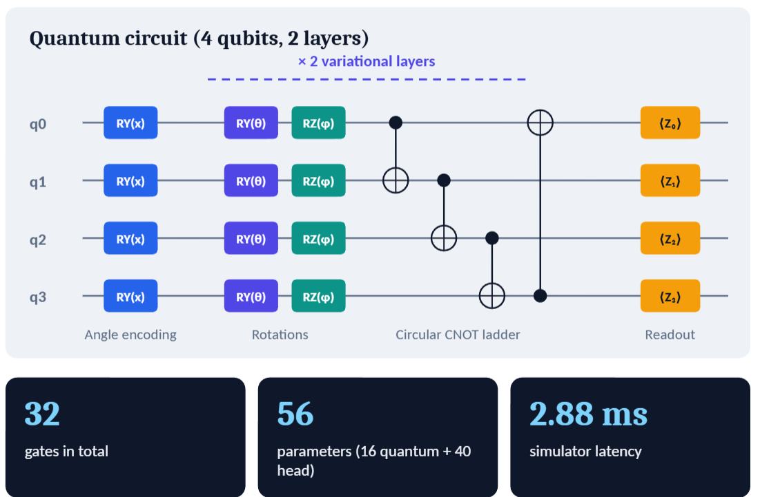
Proposed Algorithm: Flowchart & Circuit
Algorithm 2 of 3: data flow and the 4-qubit quantum circuit
Chest X-ray (224×224)
CLAHE + z-score normalisation
ResNet-18 → 512-d features
PCA → 4 angles in [0, π]
4-qubit VQC → ⟨Z₀…Z₃⟩ → sigmoid head
Notes:
Flowchart on the left shows the full data path. The circuit on the right shows angle encoding, two variational layers (RY, RZ, circular CNOT ladder) and four Pauli-Z readouts.

Slide 6
Proposed Algorithm: Pseudocode
Algorithm 3 of 3: training loop and quantum forward pass
Training
Quantum forward pass
ALGORITHM HybridVQC_Train(Images, Labels, Epochs)
1 Fit PCA on ResNet-18 training features
2 Initialise θ, φ ∈ [0, 2π]; W, b randomly
3 for epoch = 1 to Epochs:
4 for each mini-batch (x, y):
5 f ← ResNet18(CLAHE(x)) // 512-d
6 a ← π · MinMax(PCA(f)) // 4 angles
7 e ← VQC(a, θ, φ) // 4 ⟨Z⟩
8 p ← sigmoid(W·e + b) // 8 labels
9 L ← BCE(p, y)
10 ∇θ,φ ← ParameterShift(L)
11 update θ, φ, W, b (optimizer step)
12 return θ, φ, W, b
FUNCTION VQC(a[0..3], θ[2][4], φ[2][4])
state ← |0000⟩
for i = 0 to 3: // encode
RY(a[i]) on qubit i
for l = 0 to 1: // layers
for i = 0 to 3:
RY(θ[l][i]) on qubit i
RZ(φ[l][i]) on qubit i
for i = 0 to 3: // entangle
CNOT(i, (i+1) mod 4)
return [⟨Z_i⟩ for i = 0 to 3]
Gradient rule: parameter-shift (2 shifted circuit runs per parameter). Decision: ≥ 50% Detected, 25–49% Possible.
Notes:
Training loops over mini-batches: classical feature extraction and PCA feed the quantum circuit; parameter-shift gives exact gradients for the quantum angles and backpropagation handles the linear head. Loss and optimizer are the standard multi-label choices.

Slide 7
Algorithm Complexity
Classical preprocessing versus quantum circuit execution and simulation
Pipeline stage | Time complexity | Space complexity | Note
Image preprocessing (CLAHE) | O(H · W) | O(H · W) | Per-pixel tile histogram equalisation
CNN extractor (ResNet-18) | O(Σ K² Cₗ₋₁ Cₗ Hₗ Wₗ) | O(Σ Cₗ Hₗ Wₗ) | One forward convolution pass
PCA reduction | O(d² N + d³) | O(d²) | Covariance SVD, 512 → 4 dims
VQC on a QPU | O(D · M) shots | O(n) qubits | D = 2, M = 1000 shots, n = 4
Statevector simulation | O(G · 2ⁿ) | O(2ⁿ) amplitudes | Exponential on classical hardware
Parameter-shift training | O(2P · E · B · T_circ) | O(P) gradients | 2 circuit runs per parameter
How to read it. The CNN dominates the cost; the quantum circuit is tiny (4 qubits, depth 2).
O(1)
encoding depth; 32 gates in total
Notes:
Time and space complexity per stage. Key message: the quantum circuit is small and shallow; classical simulation cost is exponential in qubits but trivial at n = 4.

Slide 8
Implementation
Python full-stack framework: PyTorch, PennyLane and FastAPI
Language & tools
Multi-observable QNode (PennyLane)
@qml.qnode(dev, interface='torch', diff_method='parameter-shift')
def circuit(inputs, weights):
for i in range(n_qubits): # encode
qml.RY(inputs[i], wires=i)
for l in range(n_layers): # 2 layers
for i in range(n_qubits):
qml.RY(weights[l, i, 0], wires=i)
qml.RZ(weights[l, i, 1], wires=i)
for i in range(n_qubits):
qml.CNOT(wires=[i, (i + 1) % n_qubits])
return [qml.expval(qml.PauliZ(i)) for i in range(n_qubits)]
logits = linear_head(torch.stack(expvals))
probs = torch.sigmoid(logits)
Python 3: core language.
PennyLane 0.45.1: quantum simulator.
PyTorch 2.14: ResNet-18, training.
scikit-learn: PCA.
FastAPI: REST backend.
Tailwind + Chart.js: dashboard.
How it works. Encode 4 features, apply 2 layers, read 4 values.
Notes:
Walk through the QNode: encoding, two variational layers with CNOT ladder, and the four-observable readout, followed by the classical head.

Slide 9
Results & Analysis: Multi-Disease Findings
NIH ChestX-ray14 held-out test set, 8 thoracic findings
Input
A 224×224 chest X-ray from the test split, reduced to 4 PCA angles.
Output
8 finding probabilities plus a Grad-CAM heatmap.
Observations
VQC ties the MLP on exact-match accuracy (33.3%).
Notes:
Per-finding F1: Infiltration 0.33, Effusion 0.22, No Finding 0.63. The quantum model uses only 56 parameters.

Slide 10
Results & Analysis: Binary Pneumonia Triage
Kermany pediatric chest X-ray dataset, Normal vs Pneumonia
Input and output
Chest X-ray → Normal or Pneumonia probability.
Key observations
VQC matches the RBF SVM (83.3%).
Highest specificity: 90.9%.
Notes:
The quantum classifier reaches exact parity with the RBF SVM on accuracy and F1, which shows its decision boundary in Hilbert space is viable. Logistic regression is slightly better overall.

Slide 11
Conclusion
What was achieved and how well the algorithm performed
1
What was achieved
2
Problem addressed?
A working hybrid CNN–PCA–VQC system for 8 thoracic findings.
Yes. Scans were compressed to 4 angles and classified multi-label.
3
Key results
4
Effectiveness
85.0% label match (multi-disease); 83.3% accuracy (binary).
Competitive with classical models, but no quantum advantage.
Future work: real quantum hardware with error mitigation · CT and MRI modalities · quantum kernel SVMs · clinical validation.
Notes:
Summarise honestly: the prototype works and is competitive, but the simulator shows no quantum speed or accuracy advantage over simple classical models.

